Slide 1
KIDS ON THE GREEN
DATA SCIENCE CAPSTONE PROJECT
ROCHELLE CLARKE-GREY
August 2020

Slide 2
What do we really want to know?
Is at least one Parks of Toronto are ideally located with accessibility to elementary schools and access to private physical activity services ?

Slide 3
Scope of Problem
International Context
UNICEF’s global report, revealed t Canada ranked 25th out of 41 rich nations for child well-being
Measured 21 indicators Sustainable Development Goals for children & youth
Physical health Canada ranked 29th of 41 countries when it comes to unhealthy weight of children
Nearly 25 per cent of young people are obese, above the average of 15 per cent
Source : Canada Report Card 12:Building the Future( UNICEF,2017)
Note : Obesity is classified as having a Body Mass Index greater than 30.
Being Over weight is classified as having a Body Mass Index within the range 25 to 30.

Slide 4
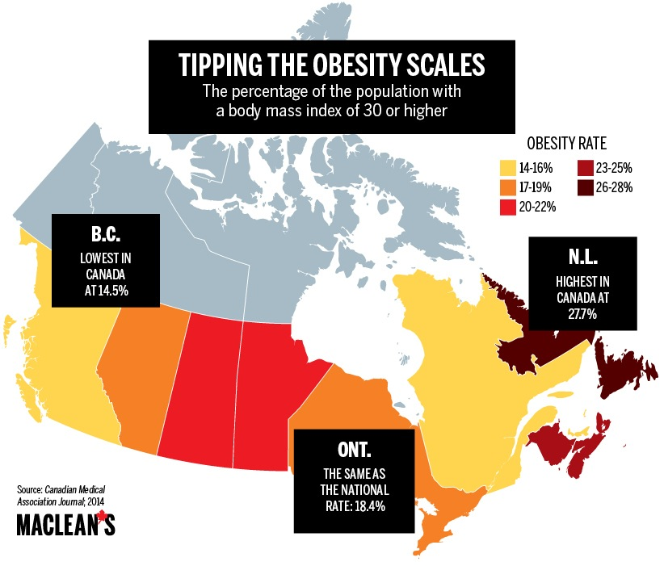
Disparity among Provinces
Health disparities among Canadian Provinces based on rate for obesity
Ontario states increased attention needed to address its rate of obesity .
Equal to national rate:18.4%

Slide 5
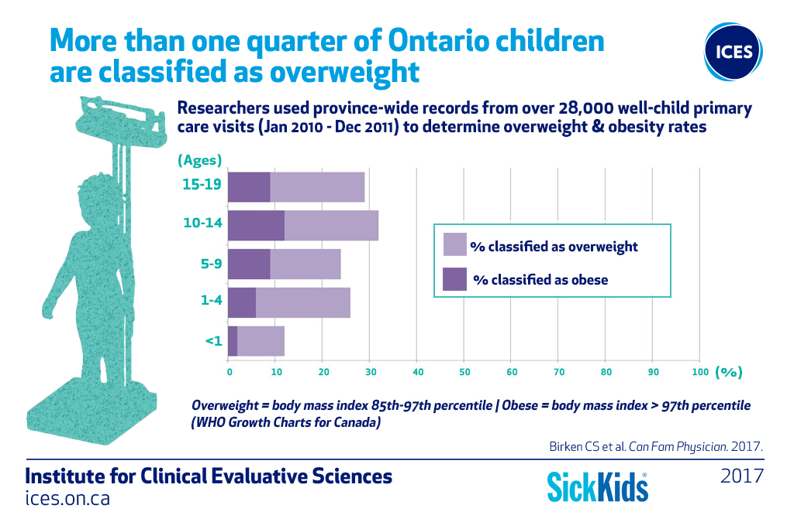
Ontario Kids
Ontario Collaborative Group for Healthy Eating and Physical Activity (OCGHEPA) advocates “for creating environments that support healthy eating & physical activity behaviours through a coordinated approach involving all relevant ministries and stakeholders and to invest in policies that help improve both healthy eating and physical activity in Ontarians in order to reduce chronic disease and health care spending” (OCGHEPA, 2018).

Slide 6
Action for Ontario Kids
Pilot green project to establish multi- sector approach for Children inclusive of school attending individuals up to 12 years old.
Identify one suitable parks operated by Toronto Parks and Recreation Services which will collaborate with elementary schools in its environs currently operating an After School Programme.
“ Kids on the Green” proposal to be reviewed based on location model for its viability in determining the best fit location.

Slide 7
Data
Secondary Data :
Toronto Neighourhood data,
Toronto Postal Codes
Source data from Wikipedia.
Foursquare Application

Slide 8
Methodology
Web scraping Wikipedia page for district list
Web scraping Wikipedia page for Geospatial Coordinates: Latitude and Longitude coordinates
Use Foursquare APT to get venue data
Assess venue category by Parks field
Perform clustering by k-means clustering
Visualise the clusters using Folium framework

Slide 9
Where is the ideal location for pilot project :Kids on the green? All of the prerequisites must be included
Park Location
Private Services that offer physical activities
Physical Activity Conducive to Elementary Kids
Access to public area and private services within close proximity
Situated in Downtown
Toronto

Slide 10
Map of Downtown Toronto Neighbourhoods

Slide 11
Area of Interest:Collated Table of Postal Codes and Geospatial Coordinates: Downtown Toronto

Slide 12
Which Neighbourhoods meets any of the criteria?
Foursquare was used to identify the top 15 common venues per venue.
The neighbourhoods of Christie,Regent Park & Harbourfront and Rosedale were identified by having at least one park.
Based numeric placement, a park was identified as
Rosedale had a park as its 1st common venue
Christie had a park as its 3rd common venue
Regent Park & Harbourfront as its 4th common venue
Rosedale has identified its top 5 common venues as:
1st:Park, 2nd:Playground, 3rd: Trail, 4th: Yoga Studio, 5th: Dance Studio

Slide 13
Rosedale meets all 5 prerequisites

Slide 14
Clustering
Are the 3 identified parks considered a cluster and located within adequate range of each other ?
even though two of the parks in the neighbourhoods :Christie and Regent Park & Harbourfront only having one criteria :park location operated by Toronto Parks and Recreation Division is.
Cluster analysis was conducted it was revealed that there was no cluster that contained all three parks of Rosedale,Christie, and Regent Park & Habourfront.
Analysis performed to generate 6 clusters for the Downtown Toronto Neighbours.

Slide 15
Best Cluster using k-means clustering
Cluster 1 presented the scope for fulfilling the five criteria in assessing an ideal location for the ‘Kids on the Green pilot project.

Slide 16
Cluster Map

Slide 17
Conclusion
Cluster 1 is the most ideal location to consider the pilot ‘Kids on the Green’ project which has its top common Venues are a Park, Playground, Trail, Yoga Studio and a Dance Studio.
All five venues can provide elementary kids with an outlet for physical activities.
Additionally, the multi-sector approach to partner with local businesses will also be achieved when the Parks of Toronto and Recreations can partner with the yoga studio and dance studio.
The ideal location within cluster 1 for the pilot ‘Kids on the Green’ programme is located in Rosedale, Downtown Toronto.

